Slide 1
The Mental Health and Wellbeing of Migrant Children in Malta
September 2018, Paris
www.tfal.org.mt

Slide 2
In 2016 , Office of the Commissioner for Children approached the Centre for Resilience and Socio-Emotional Health within the University of Malta.
it was decided to carry out a research study to identify the needs of foreign children and young people living in Malta.
Consequently the study will put forward a set of recommendations how the needs of migrant children should be adequately addressed.
Even though there are a few small scale studies on various aspects of the development of migrant children in Malta there is no comprehensive study examining the wellbeing, resilience, inclusion and education of such children.

Slide 3
Trends in Malta
In 2017 the population in Malta increased by +33 per 1000 residents, more than 15 times the rate in the EU (+2.1), bringing the population up to 475,700
Migration has become the main driver pushing up Malta's population:
the number of non-Maltese living in Malta has more than doubled over the last decade.
2017: 43,000 foreign workers in Malta: 30,564 EU nationals, 12,407 third country nationals (7,748 Italians 4,819 Britons and 2,439 Bulgarians; 2,413 Filipinos, 2,329 Serbs).

Slide 4
Non EU nationals
In 2018 there were 27,238 non-EU foreign nationals registered in Malta.
The ten countries with the most nationals registered to live in Malta:
1. Libya – 3,622
2. Serbia – 2,757
3. The Philippines – 2,407
4. Russia – 2,027
5. Somalia – 1,845
6. Syria – 1,289
7. China – 1,090
8. Eritrea – 1,057
9. Ukraine - 896
10. India – 819

Slide 5
Migrant Children
One of the main issues of this movement of people, both from the north and from the south, is the welfare of children and young people who in many instances have little say in what his happening in their lives in such circumstances.
Children living in a different country may face a number of challenges in their education, wellbeing and mental health, including linguistic and cultural barriers, lack of access to educational, psychological, social and medical services, and difficulties in social inclusion amongst others.
They may be also at heightened risk for certain mental health problems, including post-traumatic stress, depression and anxiety, particularly if not provided with adequate and timely support.

Slide 6
Objectives of the study
The study aims to determine:
The level of health, wellbeing and resilience of migrant children in Malta, and how this may vary by individual and contextual factors.
The factors related to positive mental health, wellbeing and resilience.
Inclusion in schools and within the community and what may hinder it.
Access to services.
Children’s views on their own wellbeing.
What may help to create more accessible, inclusive and resilience-enhancing spaces for migrant children.

Slide 7
Approach
The Study takes a resilience perspective.
The Study also children’s subjective wellbeing, seeking to listen to children’s own voices about their wellbeing, health, inclusion and resilience.
Study makes use of both quantitative and qualitative methods

Slide 8
Methodology
Participants - children under the age of 18 who are either born outside Malta or in Malta to non-Maltese parents.
All overseas children in Malta (and their teachers and parents/carers) who could be identified through schools, homes, centres and agencies, were invited to participate.

Slide 9
The study has been designed in 5 major parts:
Part 1: Data collection with school age children (Kindergarten - Form 5): students, parents and teachers in State, Church & Independent Schools and Open Centres.
Part 2: Data collection from students at post-secondary level.
Part 3: Data collection from carers and parents of children attending Childcare Centres.
Phase 4: Focus groups with primary and secondary migrant children currently attending state schools.
Phase 5 : Data Collection from Maltese students on their attitudes towards migrant children

Slide 10
Highest student population of overseas students by school sector and nationality (2016/17)
State Schools (primary and secondary) | 98 nationalities and 24 mixed nationalities Highest student populations (descending order): UK, Italy, Libya, Bulgaria, Syria
Church schools (primary and secondary) | 29 nationalities; highest student populations (descending order): UK, Italy, Serbia, Bulgaria, China, USA
Independent Schools (primary and secondary) | 74 nationalities and 25 mixed nationalities Highest student populations (descending order): Libya, UK, Italy, Russia, Sweden

Slide 11
Instruments
Student Questionnaires
Subjective wellbeing Questionnaire (Primary & Secondary versions) (Rees & Main, 2015)
Child and Youth Resilience Measure (Child & Youth versions) (CYRM-28, CRC, 2013)
Strengths and Difficulties Questionnaire (Secondary) (SDQ, Goodman, 1997)
Parent Questionnaires:
Access to Services Questionnaire
Child Health Questionnaire
Strengths and Difficulties Questionnaire (SDQ, Goodman, 1997)
Teacher Questionnaires:
Educational engagement questionnaire
Strengths and Difficulties Questionnaire (SDQ, Goodman, 1997)

Slide 12
Some findings

Slide 13
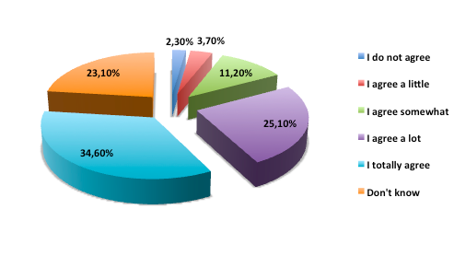
Living in Malta: Adults care about children

Slide 14
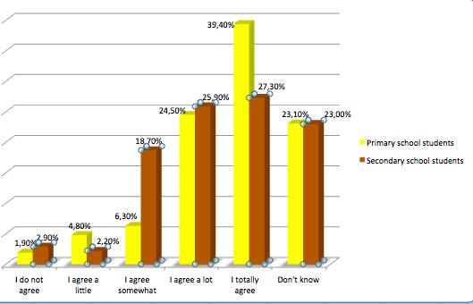
Adults care about children by age
Note: student t-test✷p>0.05

Slide 15
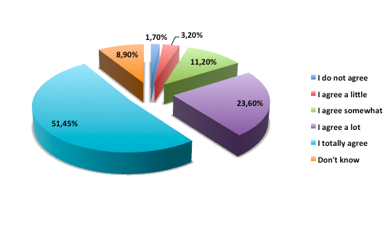
Living in Malta: Malta is a safe place for children to live

Slide 16
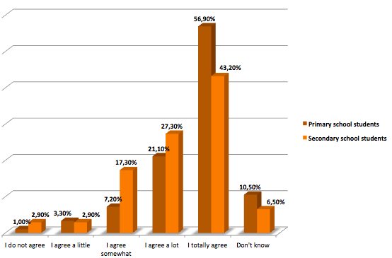
Malta is a safe place for children to live by age
Note: student t-test✷✷p>0.01

Slide 17
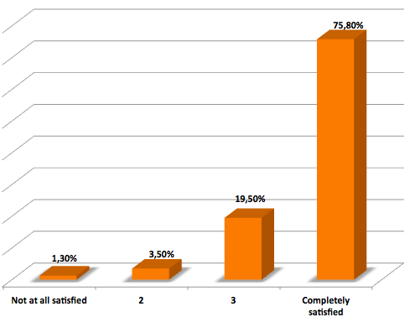
Economic well-being: How satisfied with the things you have? (Primary students)

Slide 18
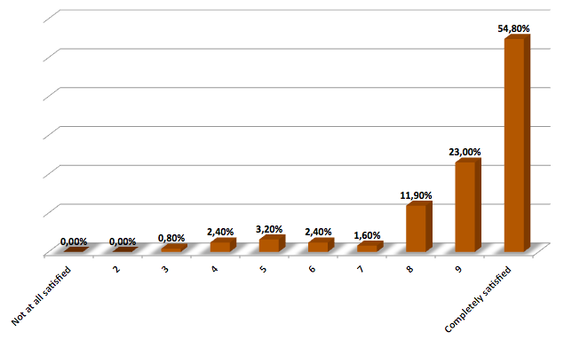
How satisfied with the things you have? (Secondary students)

Slide 19
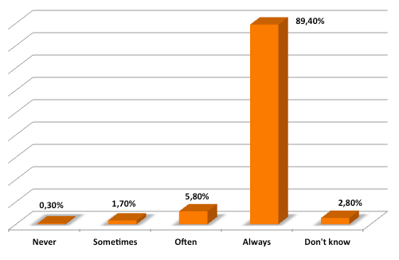
Do you have enough food to eat each day?

Slide 20
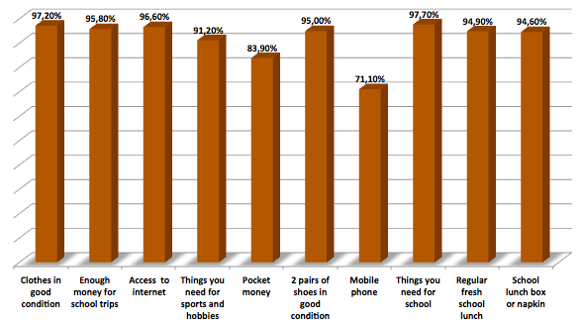
Economic well-being: Things you have

Slide 21
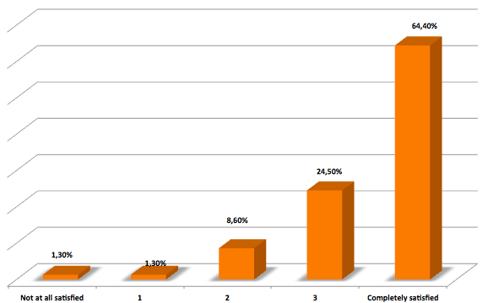
Home: How satisfied with the home you live in? (primary students)

Slide 22
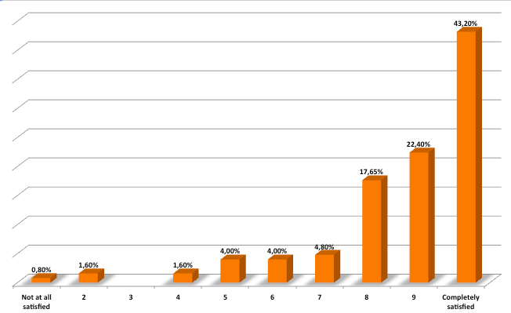
Home: How satisfied with the home you live in? (secondary students)

Slide 23
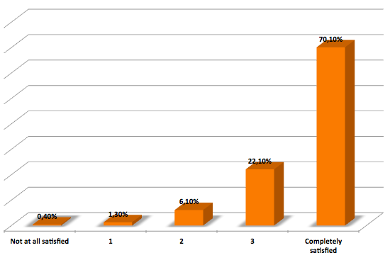
How satisfied with the area you live? (primary students)

Slide 24
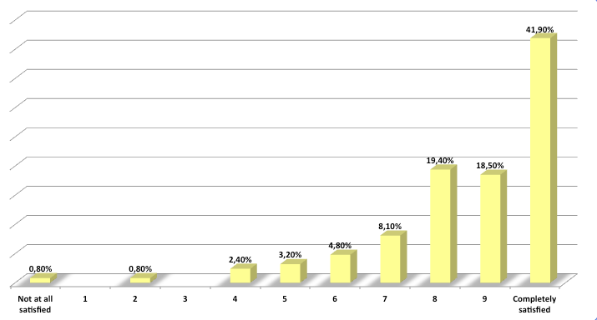
How satisfied with the area you live? (secondary students)

Slide 25
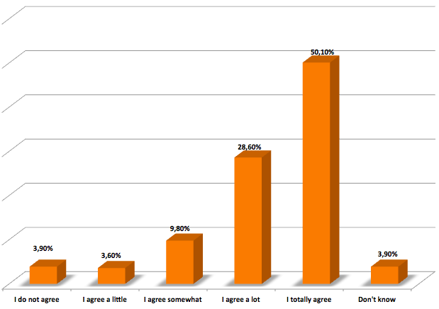
I feel safe when I walk around the area I live in

Slide 26
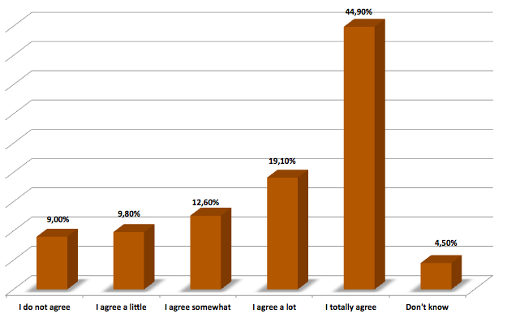
In my area there are enough places to play and have a good time

Slide 27
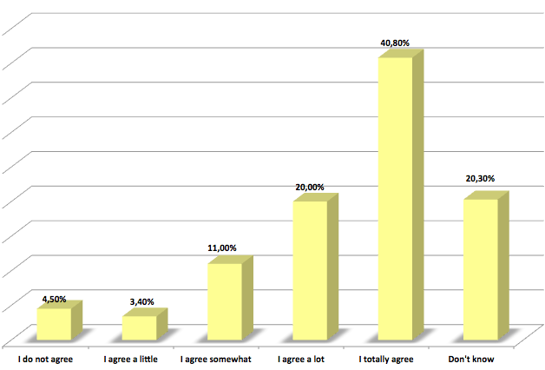
Adults in my area are kind to children

Slide 28
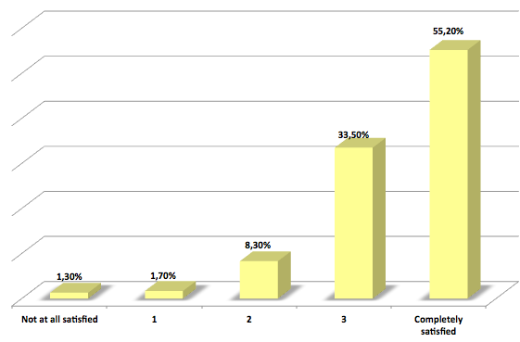
School: Your life as a student (primary students)

Slide 29
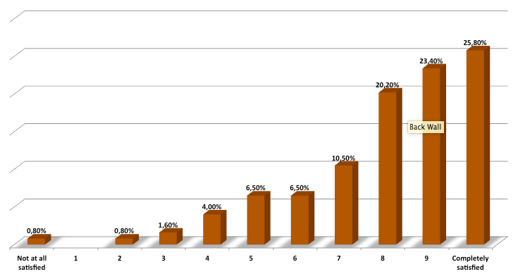
Your life as a student (secondary students)

Slide 30
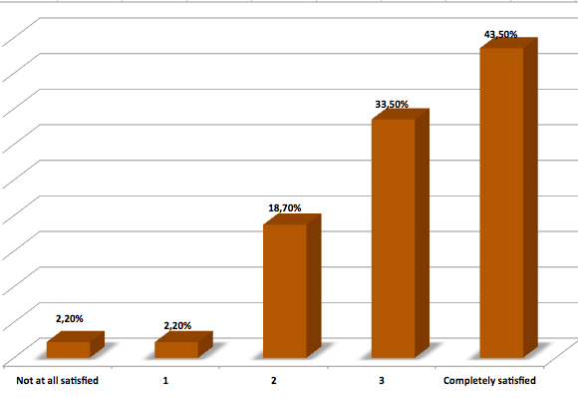
Other children in your class (primary students)

Slide 31
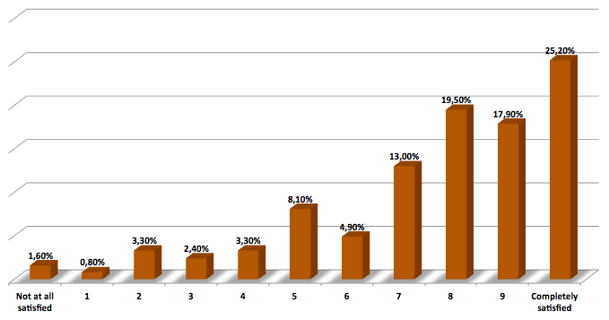
Other children in your class (secondary students)

Slide 32
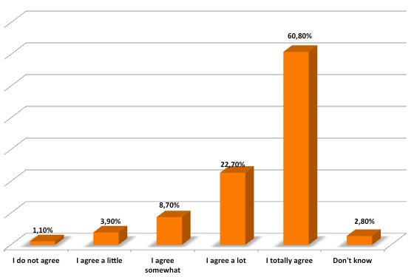
My teachers care about me

Slide 33
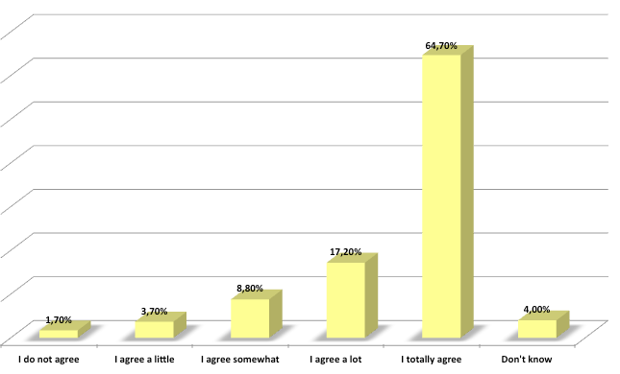
I feel safe at school

Slide 34
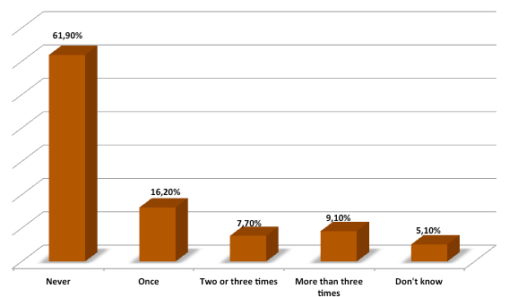
Hit by other children in school

Slide 35
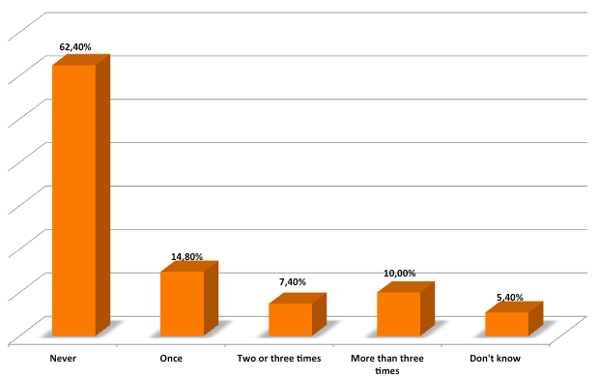
Left out by other children in class

Slide 36
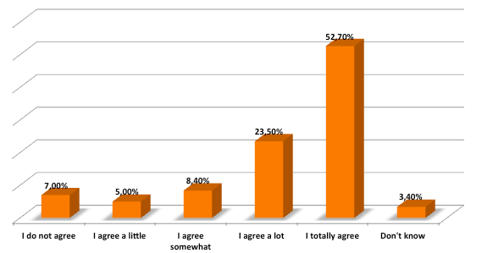
Friends: I have enough friends

Slide 37
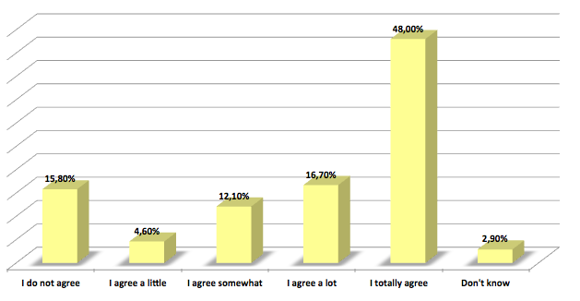
My closest friends are Maltese

Slide 38
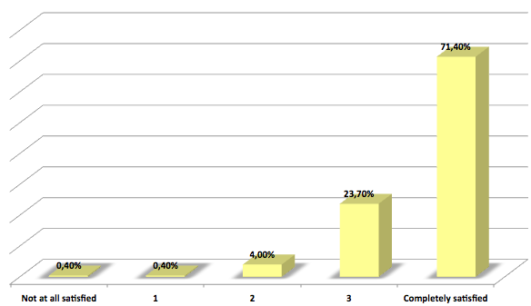
Your health (primary students)

Slide 39
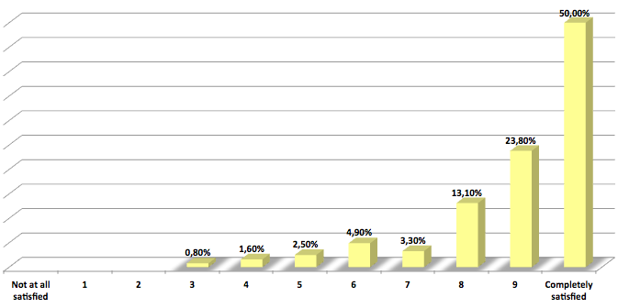
Your health (secondary students)

Slide 40
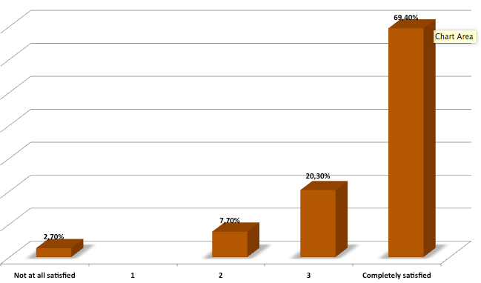
Your life as a whole (primary students)

Slide 41
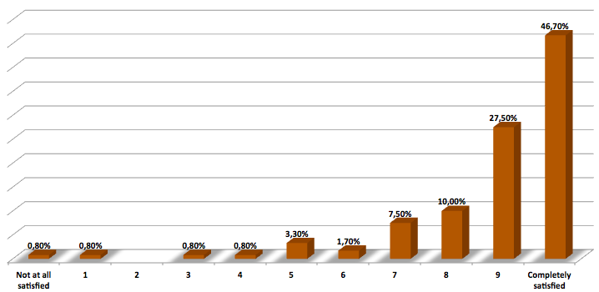
Your life as a whole (secondary students)

Slide 42
Preliminary Findings
2/3 of migrant children living in Malta are Europeans (Western and Eastern)
2/3 of the children attend state schools and there are more difficulties in state schools
SDQ scores cut off points well within the average or below, while the resilience scores quite high, suggesting a portrait of healthy, resilient children on the whole

Slide 43
Preliminary Findings
The subjective wellbeing questionnaire (voice of the children) presents a positive picture on the whole but underlines difficulties for about 15% of the children in various aspects of their lives (eg bullying, friends, locality) as well as for particular groups (eg economic wellbeing, enough food).
The findings still need to be analysed further for differences by gender, age, school, ethnicity.
The full report should be launched by the end of 2018.

Slide 44
Thank You
Email: pauline.miceli@gov.mt
Website: www.tfal.org.mt

